Slide 1

Get Mean!
Node.js and the MEAN stack

Slide 2


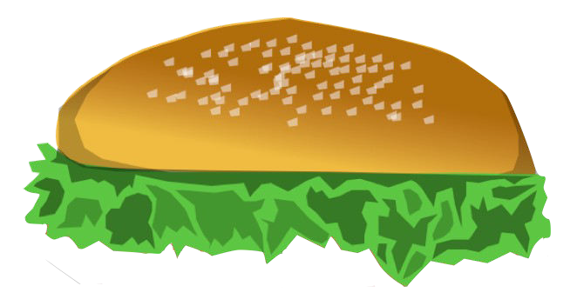



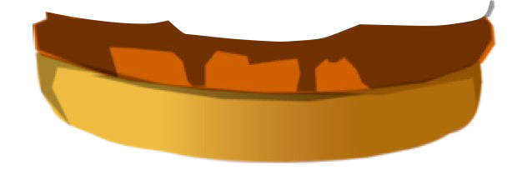

What is the MEAN Stack?
100%
JavaScript
NoSQ^{L}L!L!!!
On Sale Now
$0.00!

Slide 3



Example Application
Client
Server
Database

Slide 4

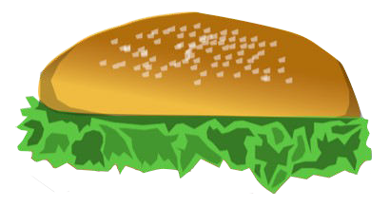
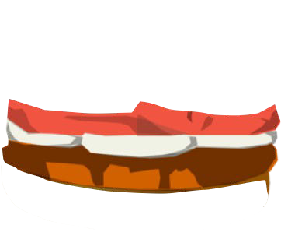

Why Go MEAN?
JavaScript all the way down Consistent models across stack Consistent best practices across stack Leverage JavaScript’s popularity

Slide 5
Example Application
Client
Server
Database

Slide 6
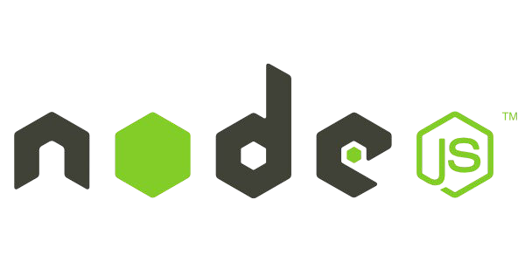
(APPLICATION PLATFORM)

Slide 7

What it does
Server-side javascript platform built on V8 engine
What javascript has done for the web browser, Node.js is doing for the backend server
Learn more at: http://nodejs.org/

Slide 8

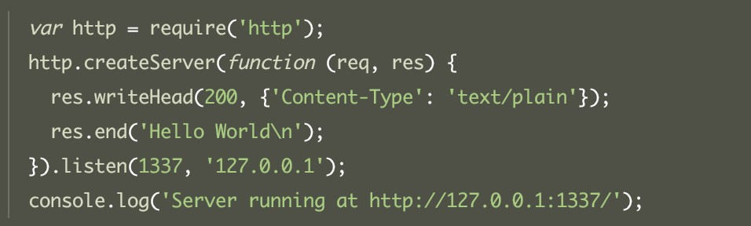
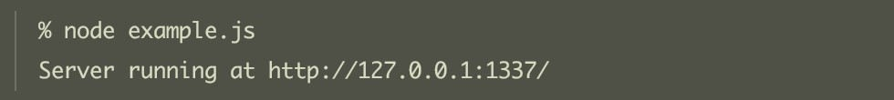
Running Node

Slide 9

NodeJS module package manager
There is a module for everything, probably more than one.
Key commands - install, remove, update, search, -g flag for global
https://npmjs.org/

Slide 10
Node.js And MEAN Stack
High performance server-side JavaScript Module loading
Asynchronous IO
Application platform foundation

Slide 11

(WEB SERVER)

Slide 12

What it does
A simple and robust web application framework for Node.js
Gives you everything you would expect to build a modern web server
Middleware, routing, templating, static-files, cookies, mime-types and much much more
Learn more at: http://expressjs.com/

Slide 13
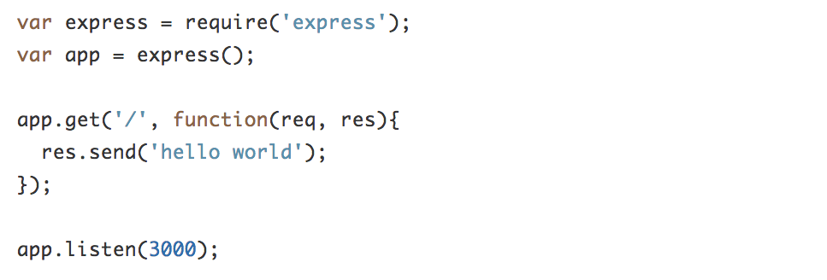
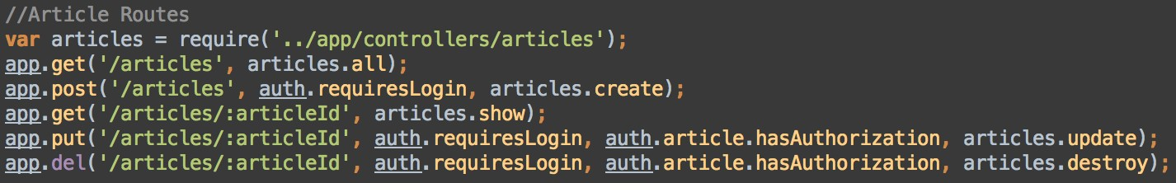
Running Express

Slide 14





PIMP YOUR STACK
(MANY OTHER NODE FRAMEWORKS)

Slide 15
Example Application
Client
Server
Database

Slide 16

(THE DATABASE)

Slide 17

What it does
A simple and scalable document based NoSQL DB
JSON based model persistence
Flexible Schemas, Query Selectors, Sharding and much much more
Learn more at: http://www.mongodb.org/

Slide 18
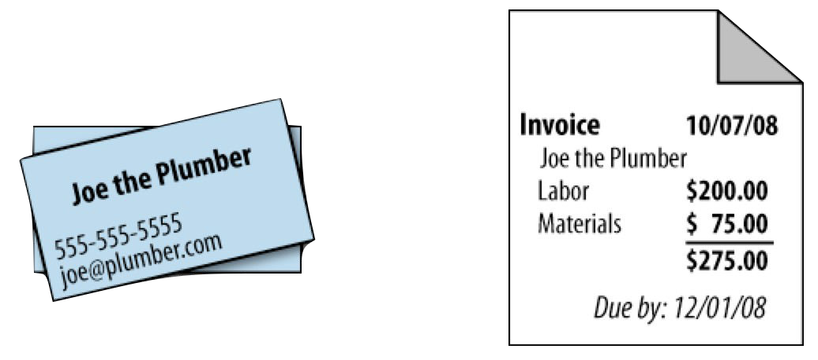

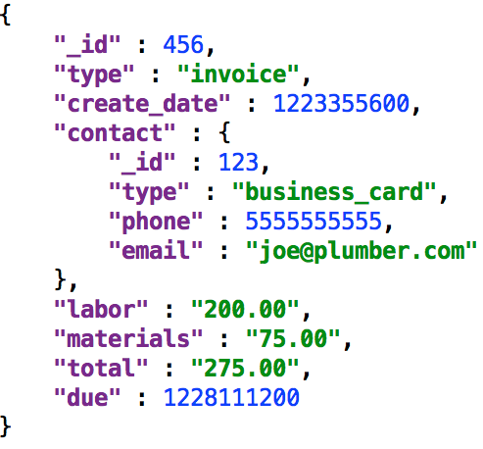

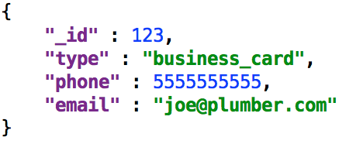
DOCUMENT DATA

Slide 19


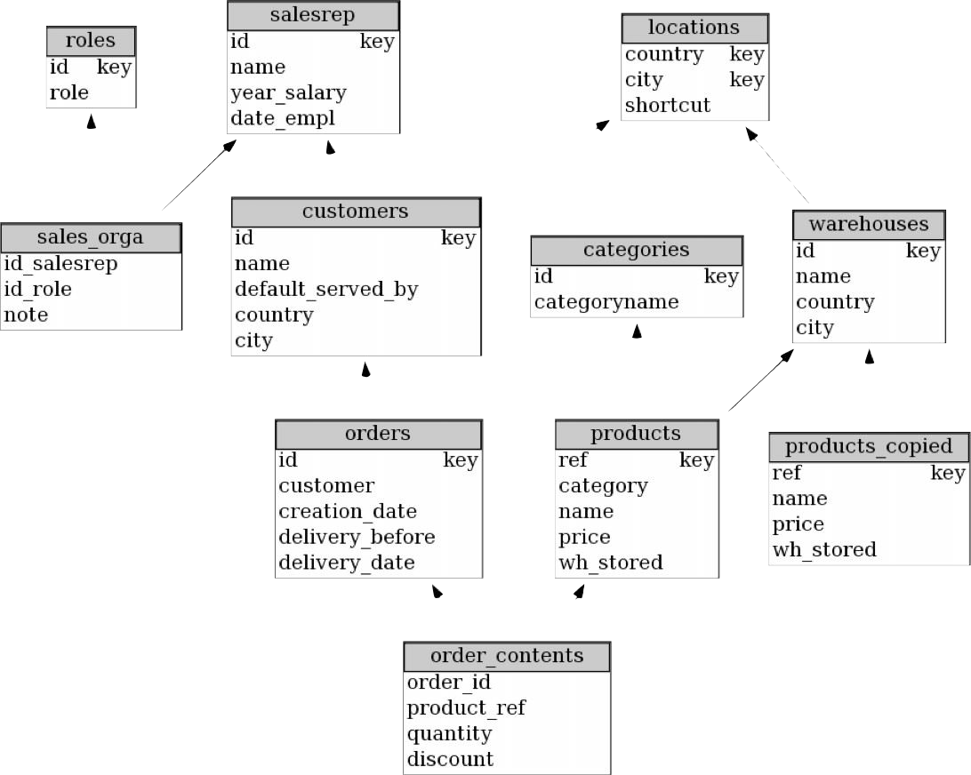
Its not SQL!

Slide 20
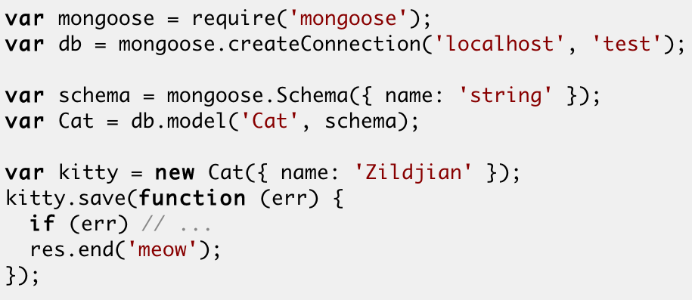
Mongoose
http://mongoosejs.com/

Slide 21


PIMP YOUR STACK
(MANY OTHER JSON DB OPTIONS)

Slide 22
Example Application
Client
Server
Database

Slide 23
(CLIENT APPLICATION)

Slide 24
What it does
An extensible client-side application framework
A swiss army knife of JavaScript MVW goodness
Data-binding, syncing, templating, components and much, much more
Learn more at: http://angularjs.org/

Slide 25
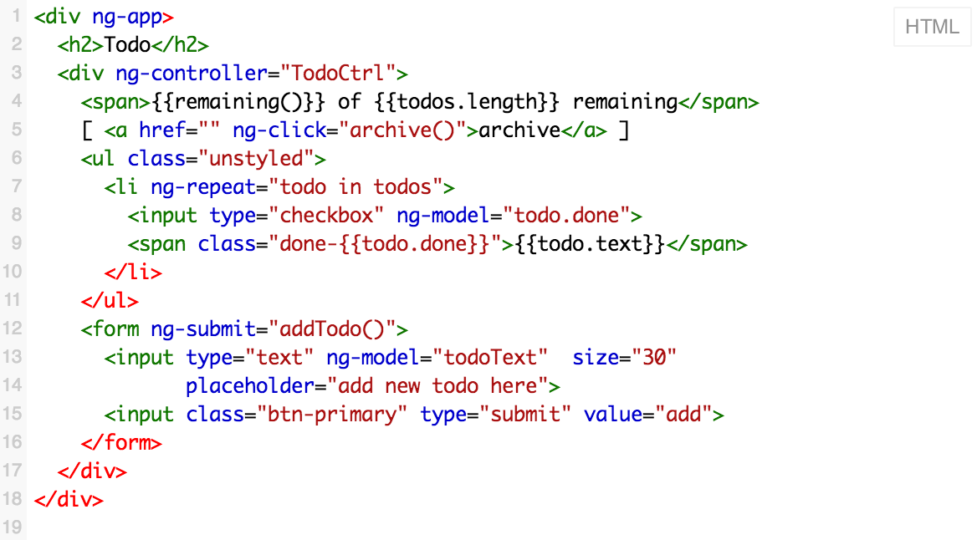
Angular Views

Slide 26

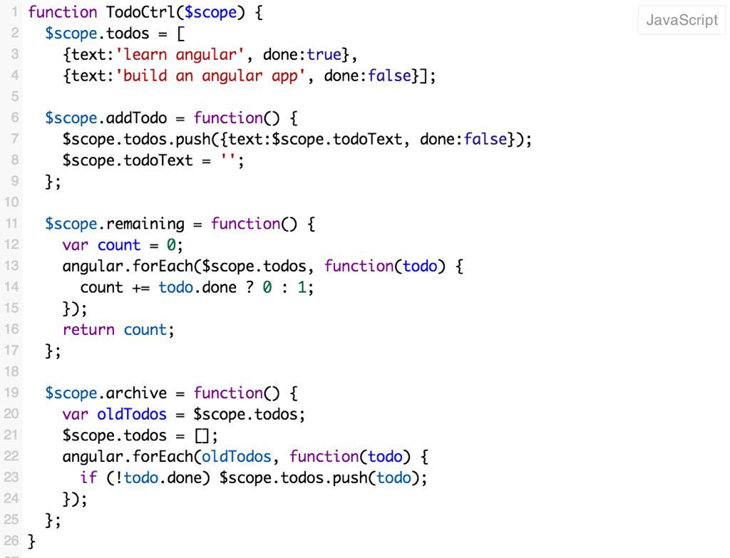
Angular Models &
Controllers

Slide 27



PIMP YOUR STACK
(OR A MILLION OTHERS)

Slide 28
LET’S GET STARTED!

Slide 29

Thanks!

